Slide 1
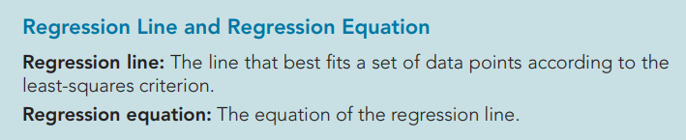
y = b0 + b1x

Slide 2
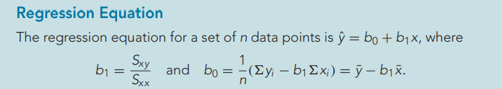

Slide 3
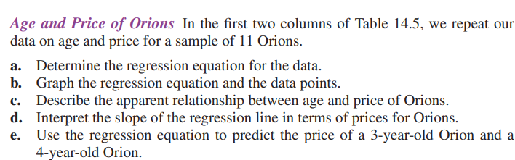
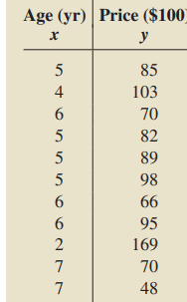

Slide 4
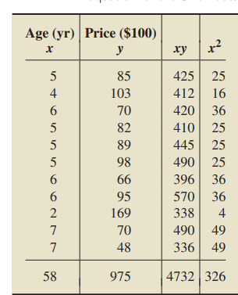
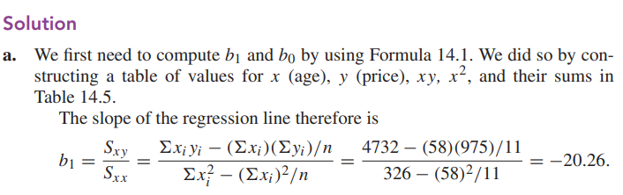

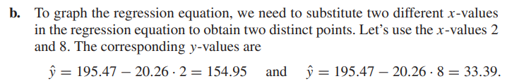

Slide 5
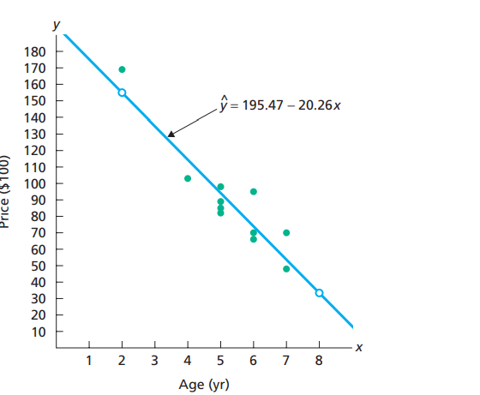
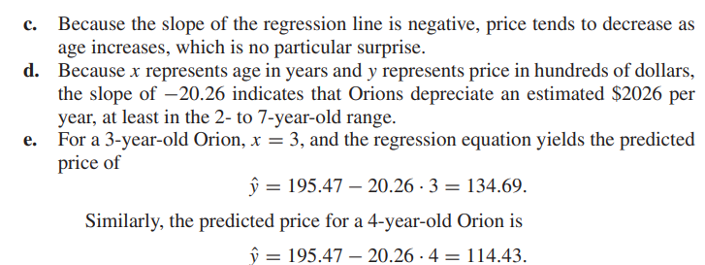

Slide 6
import numpy as np
import matplotlib.pyplot as plt
from sklearn.linear_model import LinearRegression
from sklearn.metrics import mean_squared_error
# Example data (X: independent variable, y: dependent variable)
X = np.array([1, 2, 3, 4, 5]).reshape(-1, 1) # Reshape to 2D array
y = np.array([2, 4, 5, 4, 5])
# Create a Linear Regression model
model = LinearRegression()
# Fit the model
model.fit(X, y)
# Regression coefficients
slope = model.coef_[0]
intercept = model.intercept_
# Display the regression equation
print(f"Regression equation: y = {slope:.2f}x + {intercept:.2f}")
# Make predictions
y_pred = model.predict(X)
# Calculate Mean Squared Error
mse = mean_squared_error(y, y_pred)
print(f"Mean Squared Error: {mse:.2f}")
# Plot the results
plt.scatter(X, y, color='blue', label='Actual data')
plt.plot(X, y_pred, color='red', label='Regression line')
plt.xlabel('X')
plt.ylabel('y')
plt.legend()
plt.title('Simple Linear Regression')
plt.show()

Slide 7
from sklearn.linear_model import LinearRegression
# One-liner for regression
model = LinearRegression().fit(X, y) # Fit model

Slide 8
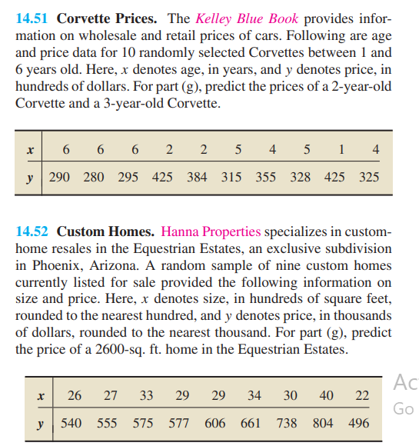

Slide 9
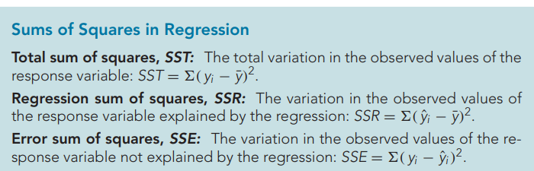

Slide 10
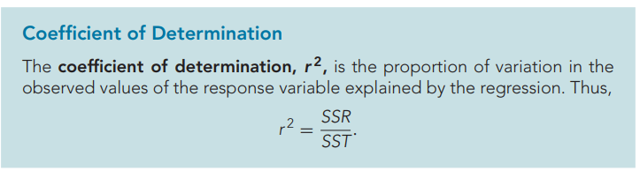


Slide 11

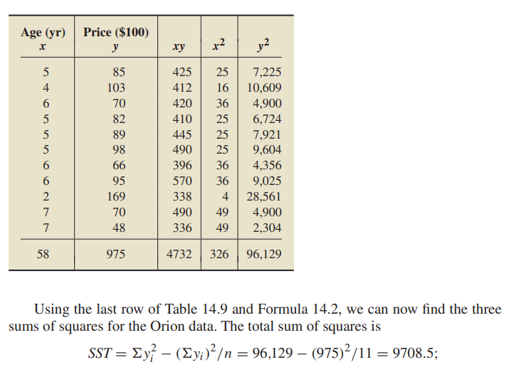

Slide 12
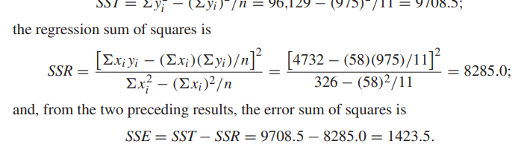

Slide 13
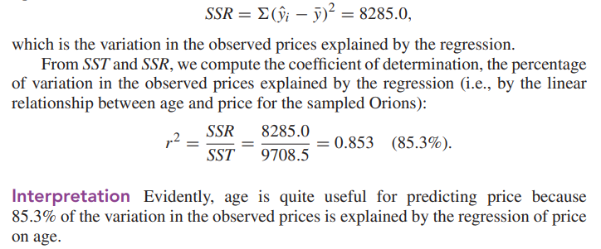

Slide 14
from sklearn.linear_model import LinearRegression
import numpy as np
# Example data
X = np.array([1, 2, 3, 4, 5]).reshape(-1, 1) # Reshape to 2D array
y = np.array([2, 4, 5, 4, 5])
# Fit the regression model
model = LinearRegression().fit(X, y)
# Get the R^2 value
r_squared = model.score(X, y)
print(f"Coefficient of Determination (R^2): {r_squared:.2f}")

Slide 15
r_squared = LinearRegression().fit(X, y).score(X, y)

